Slide 1
Analyzing Staywell Properties’ Service Requests
Francine Diep

Slide 2
OBJECTIVES
Explore and categorize the various types of service requests to identify common trends
Determine which properties have required maintenance or services.
Total number of service requests associated with each property owner.
Evaluate the total time invested in addressing service requests by calculating the cumulative hours spent on open requests and completed requests.
Notes:
The scenario we are looking at is going to focus on getting insights on which service requests are the most common. This is helpful for Staywell properties so that they can maintain the necessary contacts to help resolve tickets quickly in order to maintain their reliability with the residents requesting the service.

Slide 3
ABOUT THE DATA
The data used for this analysis is split into 6 different tables. MySQL and R Studio were the platforms used to gather the data and create tables.

Slide 4
Tables + descriptions
OWNER
Owner number
Last name
First name
Address
City
State
Zip code
SERVICE_CATEGORY
Category number
Category description
SERVICE_REQUEST
Service ID
Property ID
Category number
Office number
Description
Status
Estimated hours
Spent hours
Next service date
Notes:
For this presentation, we are working with the following tables.

Slide 5
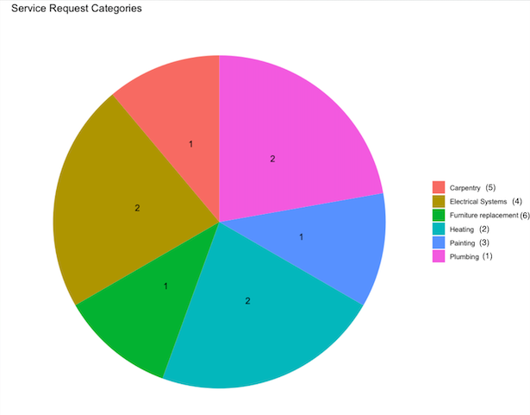
What are the service categories?
Notes:
The categories types are as follows. These are the category types that were pulled from the table “SERVICE_CATEGORY” where the categories will be referred to by the category number, which is listed in parenthesis next to the category name to the right. The numbers inside the chart represent the count of the service category, with Electrical Systems, Plumbing, and Heating being the most frequent issues.
SELECT
sc.CATEGORY_DESCRIPTION,
COUNT(sr.SERVICE_ID) AS NUM_SERVICE_REQUESTS
FROM
SERVICE_REQUEST sr
JOIN
SERVICE_CATEGORY sc
ON
sr.CATEGORY_NUMBER = sc.CATEGORY_NUM
GROUP BY
sc.CATEGORY_DESCRIPTION;

Slide 6
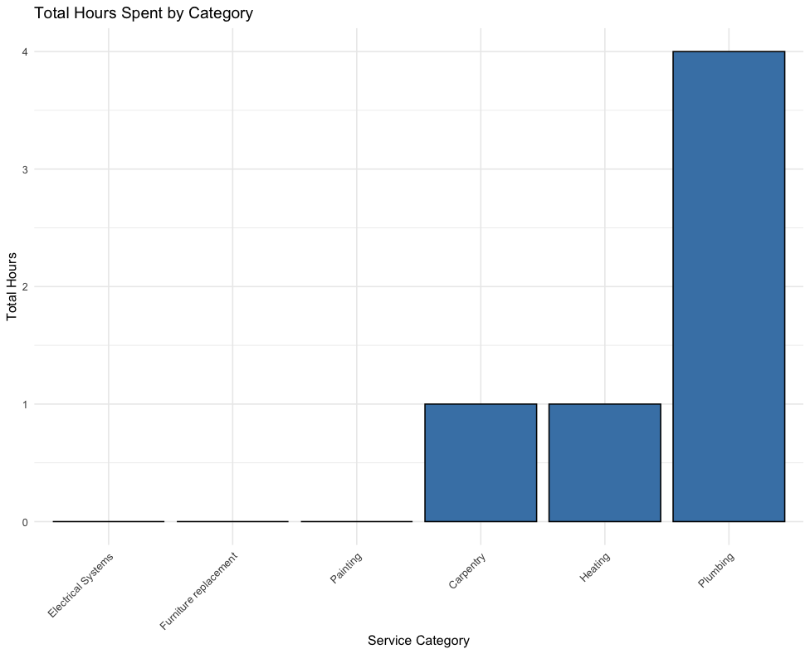
Time spent per category
*Categories 3, 4, 6 have an open status.
Notes:
I performed a join of the service request and service category tables to count the number of total hours spent in each category of service category. Plumbing category had 4 times as much time spent than the carpentry and heating category did, with the other categories with 0. Disclaimer, the categories with 0 total hours spent are currently in the status of “open, scheduled, or other”. The following slide will include a chart where we can take a look at the estimated hours.
SELECT
sr.CATEGORY_NUMBER,
sc.CATEGORY_DESCRIPTION,
COUNT(*) AS Total_Requests,
SUM(sr.SPENT_HOURS) AS Total_Hours,
ROUND(AVG(sr.SPENT_HOURS), 2) AS Avg_Hours
FROM SERVICE_REQUEST sr
JOIN SERVICE_CATEGORY sc
ON sr.CATEGORY_NUMBER = sc.CATEGORY_NUM
GROUP BY sr.CATEGORY_NUMBER, sc.CATEGORY_DESCRIPTION
ORDER BY Avg_Hours DESC;

Slide 7
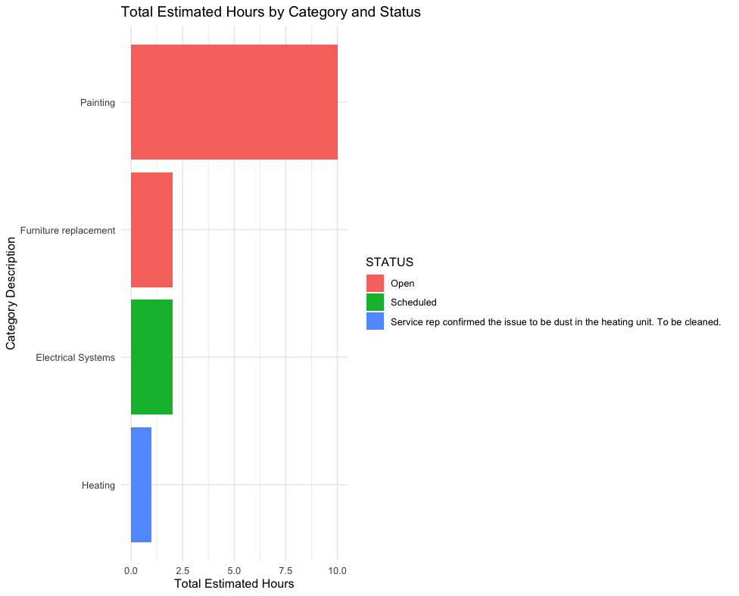
Notes:
Here are the other service requests where the status was not set to closed. Here we can see that the cumulative estimated hours to be spent for these 4 service requests is an estimated 15 hours. We can also see that two residents have a request open, one that has been scheduled, and one that seems to be in the next steps of service completion. This chart was created by performing a join of the service request table and the service category table where the table was then sorted by category number, category description, and status.
SELECT
sr.CATEGORY_NUMBER,
sc.CATEGORY_DESCRIPTION,
sr.STATUS,
COUNT(*) AS Total_Requests,
SUM(sr.EST_HOURS) AS Total_EST_Hours
FROM SERVICE_REQUEST sr
JOIN SERVICE_CATEGORY sc
ON sr.CATEGORY_NUMBER = sc.CATEGORY_NUM
WHERE SPENT_HOURS = 0
GROUP BY sr.CATEGORY_NUMBER, sc.CATEGORY_DESCRIPTION, STATUS
ORDER BY TOTAL_EST_HOURS DESC;

Slide 8
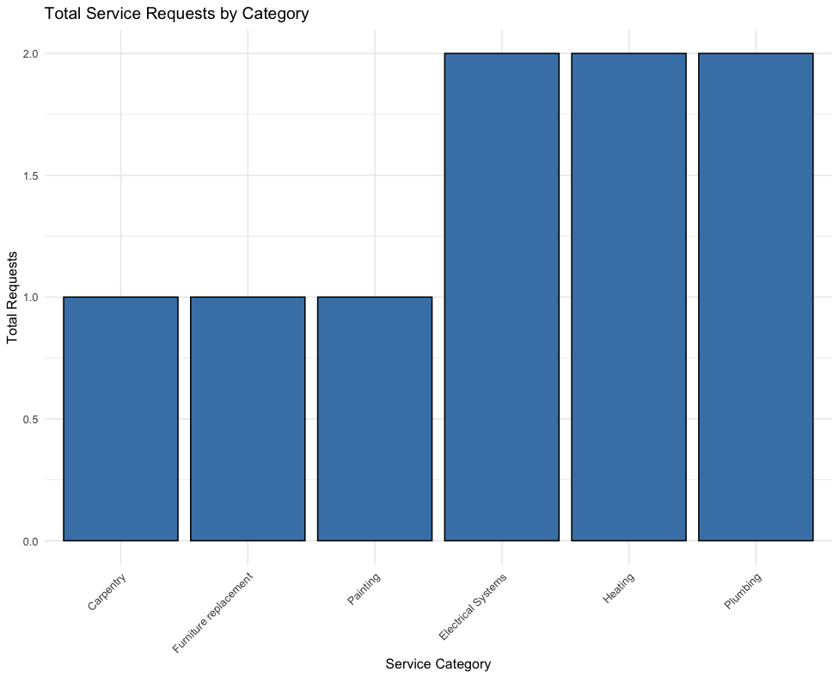
Service request count by category
Notes:
Here we have a bar chart to show the total count of requests in each category. The categories that were most frequent among the properties were electrical systems, heating, and plumbing issues.
SELECT
sr.CATEGORY_NUMBER,
sc.CATEGORY_DESCRIPTION,
COUNT(*) AS Total_Requests,
SUM(sr.SPENT_HOURS) AS Total_Hours,
ROUND(AVG(sr.SPENT_HOURS), 2) AS Avg_Hours
FROM SERVICE_REQUEST sr
JOIN SERVICE_CATEGORY sc
ON sr.CATEGORY_NUMBER = sc.CATEGORY_NUM
GROUP BY sr.CATEGORY_NUMBER, sc.CATEGORY_DESCRIPTION
ORDER BY Avg_Hours DESC;

Slide 9
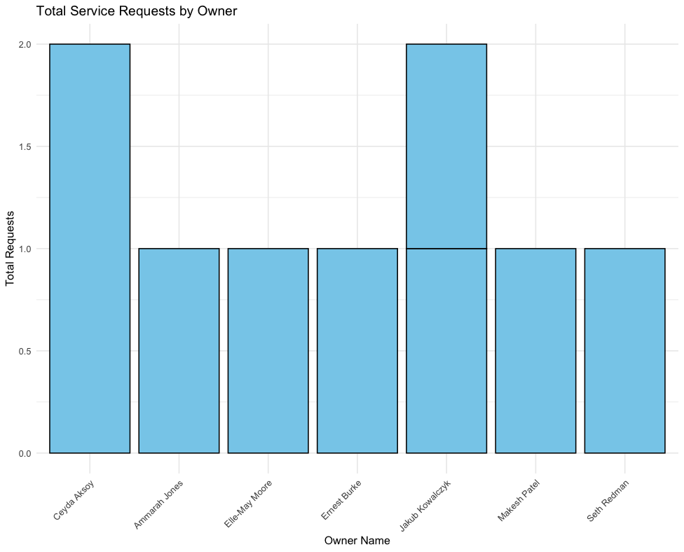
Number of service requests by owner
Notes:
This bar chart compiles a visual to see which owners have received the most requests, we can see that it was distributed mostly similar with Jakub Kowalczyk having one request per property that they own and Ceyda Aksoy having two requests in one property, and everyone else having one.
SELECT
o.OWNER_NUM,
p.PROPERTY_ID,
CONCAT(o.FIRST_NAME, ' ', o.LAST_NAME) AS OWNER_NAME,
COUNT(sr.SERVICE_ID) AS Total_Requests
FROM OWNER o
JOIN PROPERTY p ON o.OWNER_NUM = p.OWNER_NUM
JOIN SERVICE_REQUEST sr ON p.PROPERTY_ID = sr.PROPERTY_ID
GROUP BY o.OWNER_NUM, OWNER_NAME, p.PROPERTY_ID
ORDER BY Total_Requests DESC;

Slide 10
Insights gathered
The top service requests were Electrical systems, Heating, and Plumbing.
Total hours spent on completed requests was 4 hours.
Total hours estimated across open/scheduled requests is 15 hours.
Notes:
There are other factors to consider those being: the importance of resolving the service, the scheduling of the service with the resident, etc.

Slide 11
recommendations
Adding a column to keep track of the initial contact after the service request was created
1
Adding a column with the date the request was closed and a success
2
Separating the Status column to be a concise status, adding another column where the follow up steps (if applicable) can have more detail.
3
Notes:
Implications of the provided recommendations: once this is collected, the data can be used to track time it takes to schedule the initial visit, the time it takes for the actual service date, and then finally the day that the issue is resolved. The insights gained with this data will be ensuring residents are getting their issues resolved in a timely manner and to see where there can be improvements in the future where necessary. For the third recommendation, having a dedicated status column will help us have a clearer understanding of where the request is in the process instead of having the information all jumbled together.

